Slide 1
ACS 560 Course Project: Calor Mobile Application
Kevin Villela
Phillip Bercot

Slide 2
Outline
Background
Did we do it?
Demonstration
Aftermath

Slide 3
The Project
Problem: Where should I eat given nutritional restrictions?
Examples:
On a diet, and I have a maximum of 100 mg of sodium left
Just finished working out, and want a minimum of 15 grams of fat in my meal
Am trying to lower my cholesterol
Answer: NutriFacts Mobile App
Enter nutritional constraints
Gives you restaurants where you can eat
Includes all approved menu items

Slide 4
Users of Application
People who are…
Athletes
Trying to lose weight
Trying to gain weight
Trying to find a healthy place to eat
Trying to find an unhealthy place to eat
Those with Diabetes or other diseases

Slide 5
Why We Chose This Project
A way to find out what you can eat at restaurants and stay on target.
Useful for others
Useful for us
Interesting
New Language (Lua)
New Framework (Corona)
Notes:
Useful for others = an application that people might actually download.
Useful for us = another line on the resume. An app that has X downloads and is on the app store is something to show employers.
Interesting = As an athlete, it’d be great to have handy access to what is available on a restaurants menu.

Slide 6
Outline
Background
Did we do it?
Demonstration
Aftermath

Slide 7
Non-Functional Requirements
Pass App Store Requirements
Client/Server architecture
Client (mobile application) will run on iOS and be written in Objective-C or a bootstrapped language on top of Objective-C
Server will run on Linux and be written in php with JSON
Server connects to database of restaurant menus with nutritional information
Database will have nutritional information for at least 5 restaurants.
Notes:
The application must pass Apple’s application requirements to get on the Apple Application store.

Slide 8
Functional Requirements
R1: Users will be able to select a restaurant from at least 5 restaurants.
R2: Users will be able to input a number of calories, grams of fat, grams of cholesterol, and mgof sodium.
R3: Application will gather nutritional information from server each time a user makes a query.
R4: Users will be able to view all available options that keep them under their nutritional restrictions from the restaurant they chose.

Slide 9
Outline
Background
Did we do it?
Demonstration
Aftermath

Slide 10
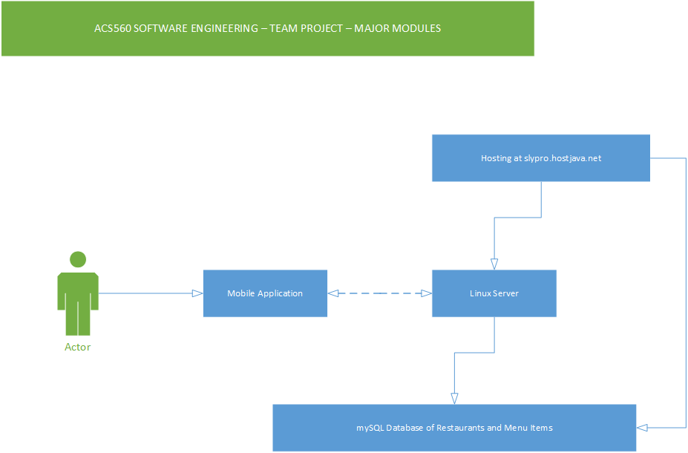
Major Modules

Slide 11
Web API
http://slypro.hostjava.net/NutriFacts.php
Returns Restaurant Type as well
All data in JSON
Parsed and recorded by the application
App re-queries database for every change in
constraints

Slide 12
Demo

Slide 13
Outline
Background
Did we do it?
Demonstration
Aftermath

Slide 14
Next Steps
Connect to larger database
Store Location data for restaurants
Give directions to restaurants
Connect to Yelp or other apps
Partner with organizations such as gyms

Slide 15
Q&A
Any questions?

